Slide 1
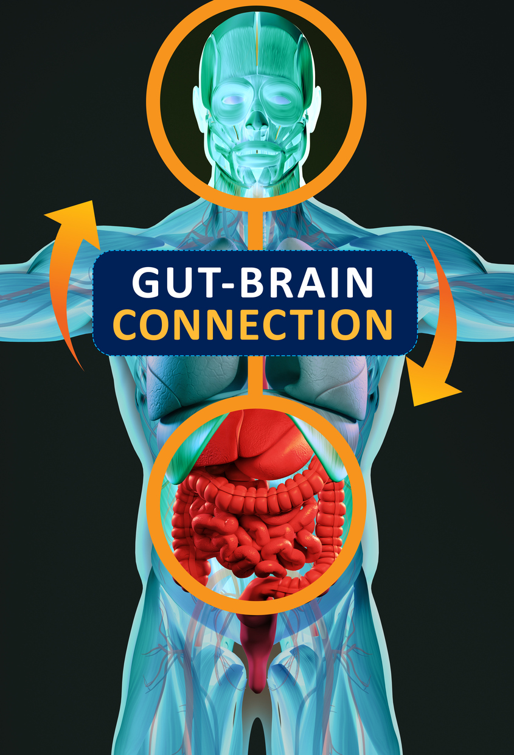
The gut-brain connection
By: Collin Merkel

Slide 3
General effects of connection
Hunger and satiety
Sensitive to emotion
Can trigger symptoms
Intestinal distress can be cause or product of emotion
Thought of eating releases enzymes
Psychosocial influence on gut
Physical improvements through psychological therapies

Slide 4
Gut-Brain Axis
100 – 500 million neurons in the gut
Vagus nerve
Stress inhibits signal
GI diseases inhibit signal
Probiotic reduced stress in mice
Inflammation in gut and brain disorders
LPS
Sleep linked to more diverse gut microbiome

Slide 6
The “mini-Brain”
Enteroendocrine cells
Release hormones
Synapse like structures
Electrical connection to vagal neurons (glutamate)
Serotonin in the gut
-Spore forming bacteria
Stimulation increases dopamine
SCFA
Propionate attenuates reward-based eating in striatal pathways
Decrease BOLD signal
GABA

Slide 7
Impact on health
Lead to better gut health
Reduce stressors -> reduce inflammation
Prevent infections
Less perceived pain in gut
Normal bile production
Mental Well-being
Modulation of tryptophan
Affects of leptin, ghrelin, peptide YY etc.
Cortisol reduction
Sleep

Slide 8
Future research
Affect of probiotics on health
Modulation of hormones, enzymes, SCFA, etc.
Affect of various foods
Tryptophan rich foods, polyphenol rich foods
Overall purpose of connection
Info about caloric intake, nutrients

Slide 9
References
Byrne, C. S., Chambers, E. S., Alhabeeb, H., Chhina, N., Morrison, D. J., Preston, T., … Frost, G. S. (2016). Increased colonic propionate reduces anticipatory reward responses in the human striatum to high-energy foods. The American Journal of Clinical Nutrition, 104(1), 5–14. doi: 10.3945/ajcn.115.126706
Clarke, G., Stilling, R. M., Kennedy, P. J., Stanton, C., Cryan, J. F., & Dinan, T. G. (2014). Minireview: Gut Microbiota: The Neglected Endocrine Organ. Molecular Endocrinology, 28(8), 1221–1238. doi: 10.1210/me.2014-1108
Harvard Health Publishing. (n.d.). The gut-brain connection. Retrieved from https://www.health.harvard.edu/diseases-and-conditions/the-gut-brain-connection.
Robertson, R. (2018, June 27). Medical information and health advice you can trust. Retrieved October 28, 2019, from https://www.healthline.com/.
UnderwoodSep, E., NormileOct, D., MervisOct, J., MervisOct, J., Feldwisch-DrentrupOct, H., WesselOct, L., … FrederickSep, E. (2018, September 26). Your gut is directly connected to your brain, by a newly discovered neuron circuit. Retrieved from https://www.sciencemag.org/news/2018/09/your-gut-directly-connected-your-brain-newly-discovered-neuron-circuit.

